Slide 1


Week 10 -
React Native
Lets get into mobile apps ?
Ahmed Fouad Lotfy
React Session Lead

Slide 2

Agenda
What we'll cover in this session
What is React Native?
Why React Native?
How to use React Native?
Mobile Screens and Views
Live Demo

Slide 3
1
HTML/CSS
Week Prerequisites you don't have to be a master
2
JavaScript
3
React
4
Redux

Slide 4

What is React Native?
It allows developers to build mobile apps using JavaScript and React.
Write once, deploy to both iOS and Android platforms.
Launched by Facebook in 2015 and became open-source in the same year. Uses native components, meaning you get the performance benefits of native apps.

Slide 5
Why choosing React Native?
Cross-Platform
Fast Development
Performance
Active Community
Cost-Effective
Companies like Instagram, Airbnb, and Facebook that use React Native.

Slide 6

Expo CLI
React Native CLI
Small to medium apps, quick prototyping
Large, scalable apps needing custom native features
Setup: Simple, fast, no native code required.
Development Speed: Faster development, live preview with Expo Go.
Custom Native Modules: Hard to integrate custom modules.
Native Code Access: Limited.
App Size: Larger initial size.
Setup: Complex, requires native tools (Xcode, etc.)
Development Speed: Slower due to manual native configuration.
Custom Native Modules: Easy to add and configure custom native code.
Native Code Access: Full Control.
App Size: Smaller, can optimize more.
Expo CLI vs React Native CLI

Slide 7
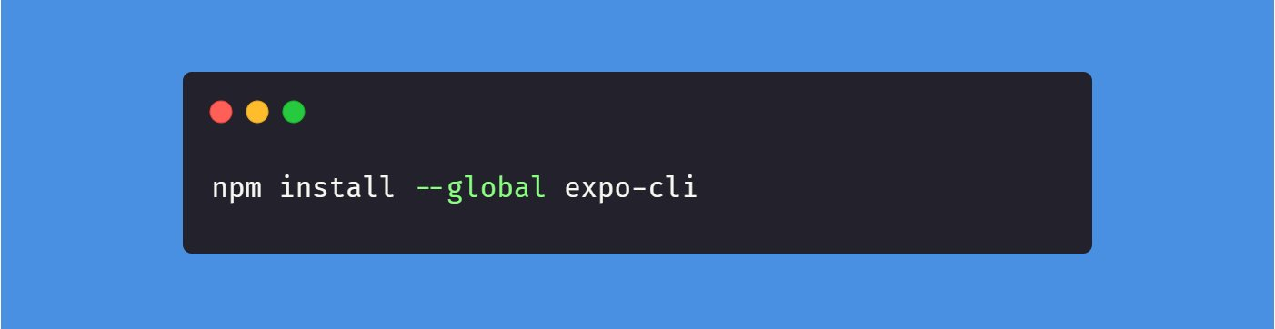
How to use React Native?
Installation: Use npm to install Expo CLI.
Most Famous Frontend Framework

Slide 8
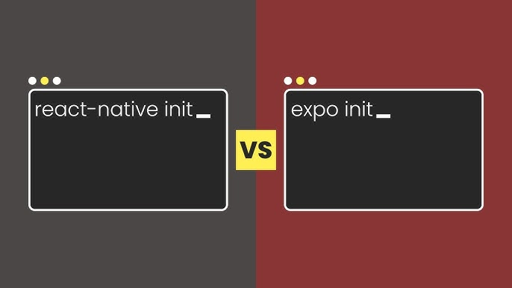
How to use React Native?
Setup: We use CLI to create a new app.
Most Famous Frontend Framework

Slide 9
Mobile Screens & Views
Views: Similar to div in HTML, a container for other elements.
Flexbox: Used for layout, handling responsiveness across screen sizes.
Components: Pre-built elements like <Text>, <Image>, <Button>, and more.
Screens: Multiple screens handled via navigation libraries like react-navigation.
Most Famous Frontend Framework

Slide 10
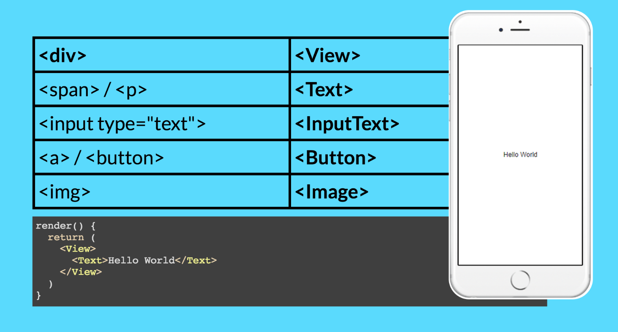
Mobile Screens & Views
Uni-directional Data flow
Most Famous Frontend Framework

Slide 11

Demo Time

Slide 12



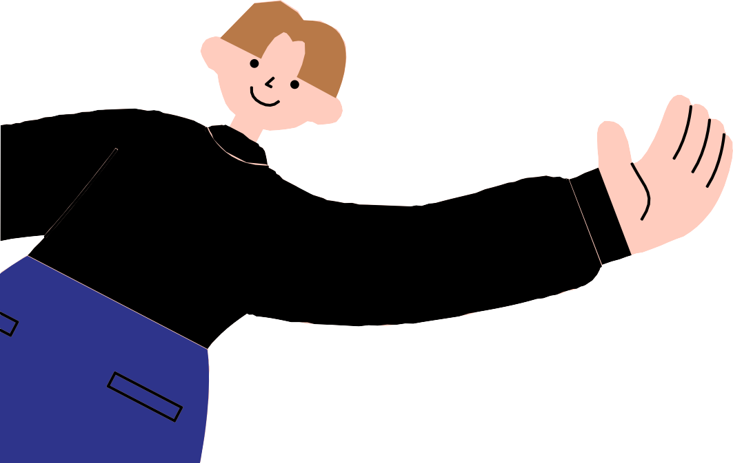
Any Questions?

Slide 13

Next Session:
More React Native

Slide 14
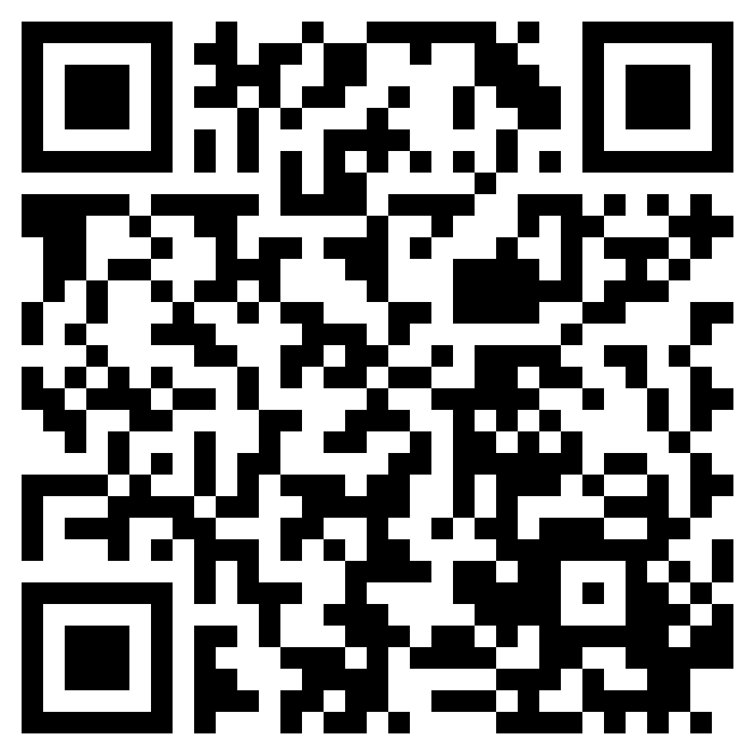
Session Survey
https://survey.udacity.com/en/SV_effyCUbT8Piw1O6?meet_id=ahmed

Slide 15
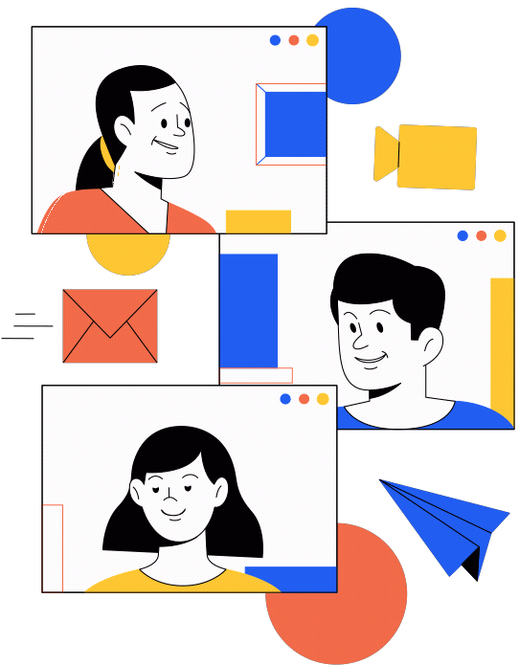

Thank you for attending!
Feel free to email at a.lotfy@fci-cu.edu.eg or reach me at circle anytime for any questions or clarifications!
Follow me on Github @ahmeddxfouad
code and slides are found at this github repo

